Slide 1

CMPT 413/713: Natural Language Processing
Sequence to Sequence Models
(Seq2Seq)
Zhiyun (Richard) Peng
2026-10-23
Adapted from slides from Angel Chang, Anoop Sarkar, Danqi Chen, Karthik Narasimhan, and Justin Johnson, Chris Manning, Abigail See, Andrej Karpathy, Graham Neubig
Notes:
http://demo.clab.cs.cmu.edu/NLP/

Slide 2
Overview
Sequence generation tasks
Seq2Seq models - Encoder/Decoder
Decoding strategies
Evaluating text generation
Attention

Slide 3
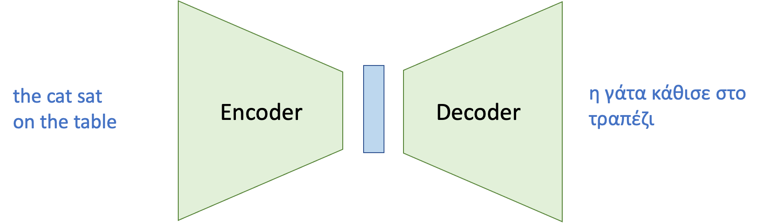
Want computer friendly representation for applications
Greek
Latent
representation
Understanding what is said
(encoding, feature extraction)
Deciding what to say
(decoding, generating)

Slide 4
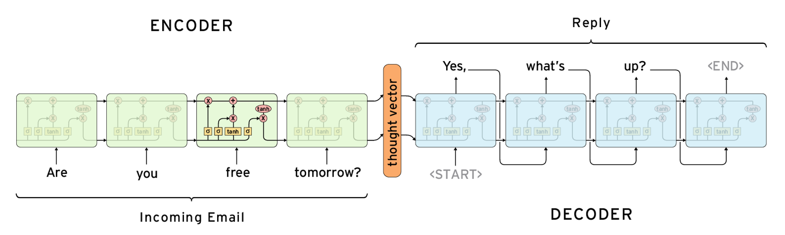
Encoder-Decoder Model

Slide 5
Seq2Seq Tasks and Applications
Task/Application | Input | Output
Machine Translation | French | English
Summarization | Document | Short Summary
Dialogue | Utterance | Response
Parsing | Sentence | Parse tree (as sequence)
Question Answering | Context + Question | Answer
Notes:
Seq2seq finds applications in many other tasks!
Any task where inputs and outputs are sequences of words/characters

Slide 6
Cross-Modal Seq2Seq
Task/Application | Input | Output
Speech Recognition | Speech Signal | Transcript
Image Captioning | Image | Text
Video Captioning | Video | Text
Vision-Language Navigation | Text | Actions

Slide 7
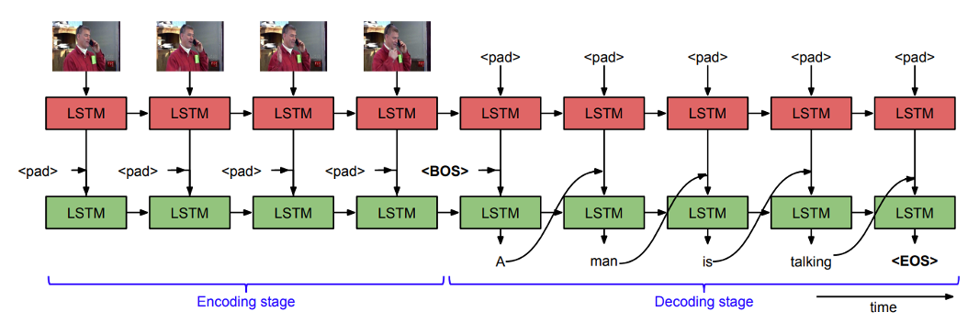
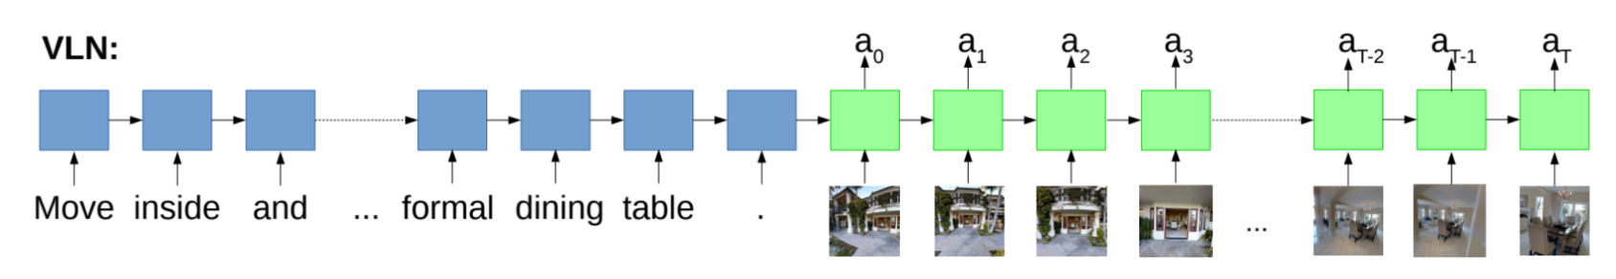
Cross-modal sequence generation
Video captioning (video frames to text)
Embodied AI (text + frames to actions)
Vision-Language Navigation (VLN)

Slide 8
Seq2Seq Tasks and Applications
Task/Application | Input | Output
Machine Translation | French | English
Summarization | Document | Short Summary
Dialogue | Utterance | Response
Parsing | Sentence | Parse tree (as sequence)
Question Answering | Context + Question | Answer
Notes:
Seq2seq finds applications in many other tasks!
Any task where inputs and outputs are sequences of words/characters

Slide 9
Neural Machine Translation
A single neural network is used to translate from source to target
Architecture: Encoder-Decoder
  Two main components:
    Encoder: Convert source sentence (input) into a vector/matrix
    Decoder: Convert encoding into a sentence in target language (output)

Slide 10
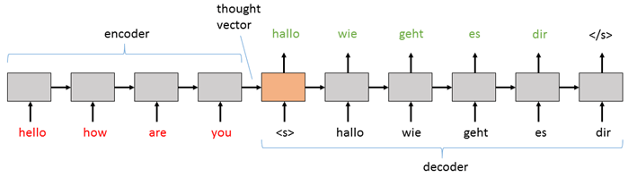
Sequence to Sequence learning (Seq2seq)
Encode entire input sequence into a single vector (e.g. using an RNN)
Decode one word at a time (e.g. using an RNN!)
Beam search for better inference
Learning is not trivial! (vanishing/exploding gradients)
(Sutskever et al., 2014)

Slide 11
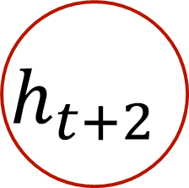
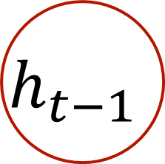
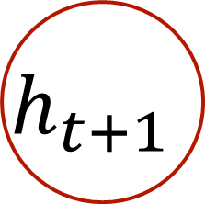
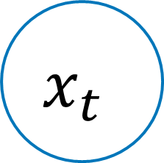
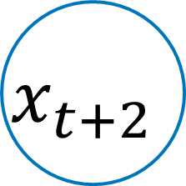

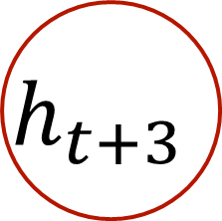


Encoder
Sentence: This cat is cute
h
$$h_{t−1}$$
$$h_{t}$$
$$h_{t+1}$$
$$h_{t+2}$$
$$h_{t+3}$$
$$x_{t}$$
$$x_{t+1}$$
$$x_{t+2}$$
$$x_{t+3}$$
word
embedding
This cat is cute

Slide 12
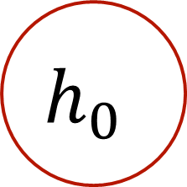


Encoder
Sentence: This cat is cute
h
$$h_{0}$$
$$h_{1}$$
$$h_{t+1}$$
$$h_{t+2}$$
$$h_{t+3}$$
$$x_{1}$$
$$x_{t+1}$$
$$x_{t+2}$$
$$x_{t+3}$$
word
embedding
This cat is cute

Slide 13
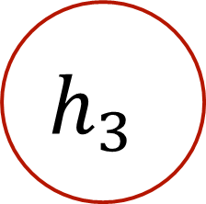

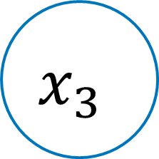



Encoder
Sentence: This cat is cute
h
$$h_{4}$$
$$h_{0}$$
$$h_{1}$$
$$h_{2}$$
$$h_{3}$$
$$h_{t+3}$$
$$h_{t+2}$$
$$x_{4}$$
$$x_{1}$$
$$x_{2}$$
$$x_{3}$$
$$x_{t+3}$$
$$x_{t+2}$$
word
embedding
This cat is cute

Slide 14

Encoder
Sentence: This cat is cute
(encoded representation)
$$h^{enc}$$
$$h_{0}$$
$$h_{1}$$
$$h_{2}$$
$$h_{3}$$
$$h_{4}$$
$$x_{1}$$
$$x_{2}$$
$$x_{3}$$
$$x_{4}$$
word
embedding
This cat is cute

Slide 15
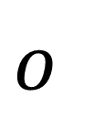
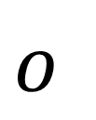
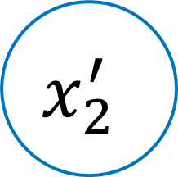
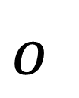
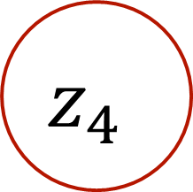

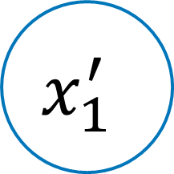
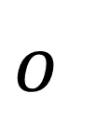
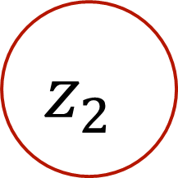
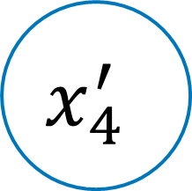


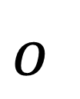



Decoder
ce
chat
est
mignon
<e>
$$o$$
$$o$$
$$o$$
$$o$$
$$o$$
$$h^{enc}$$
$$z_{1}$$
$$z_{2}$$
$$z_{3}$$
$$z_{4}$$
$$z_{5}$$
$$x_{1}^{′}$$
$$x_{2}^{′}$$
$$x_{3}^{′}$$
$$x_{4}^{′}$$
$$x_{5}^{′}$$
word
embedding
<s> ce chat est mianon
mignon

Slide 16
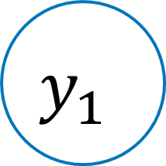
Decoder
ce
chat
est
mignon
<e>
$$o$$
$$o$$
$$o$$
$$o$$
$$o$$
$$h^{enc}$$
$$z_{1}$$
$$z_{2}$$
$$z_{3}$$
$$z_{4}$$
$$z_{5}$$
$$y_{1}$$
$$x_{2}^{′}$$
$$x_{3}^{′}$$
$$x_{4}^{′}$$
$$x_{5}^{′}$$
word
embedding
<s> ce chat est mianon
mignon

Slide 17
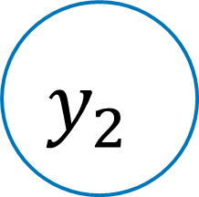
Decoder
ce
chat
est
mignon
<e>
$$o$$
$$o$$
$$o$$
$$o$$
$$o$$
$$h^{enc}$$
$$z_{1}$$
$$z_{2}$$
$$z_{3}$$
$$z_{4}$$
$$z_{5}$$
$$y_{1}$$
$$y_{2}$$
$$x_{3}^{′}$$
$$x_{4}^{′}$$
$$x_{5}^{′}$$
word
embedding
<s> ce chat est mianon
mignon

Slide 18



Decoder
A conditioned language model
ce
chat
est
mignon
<e>
$$o$$
$$o$$
$$o$$
$$o$$
$$o$$
$$h^{enc}$$
$$z_{1}$$
$$z_{2}$$
$$z_{3}$$
$$z_{4}$$
$$z_{5}$$
$$y_{1}$$
$$y_{2}$$
$$y_{3}$$
$$y_{4}$$
$$y_{5}$$
word
embedding
<s> ce chat est mignon

Slide 19
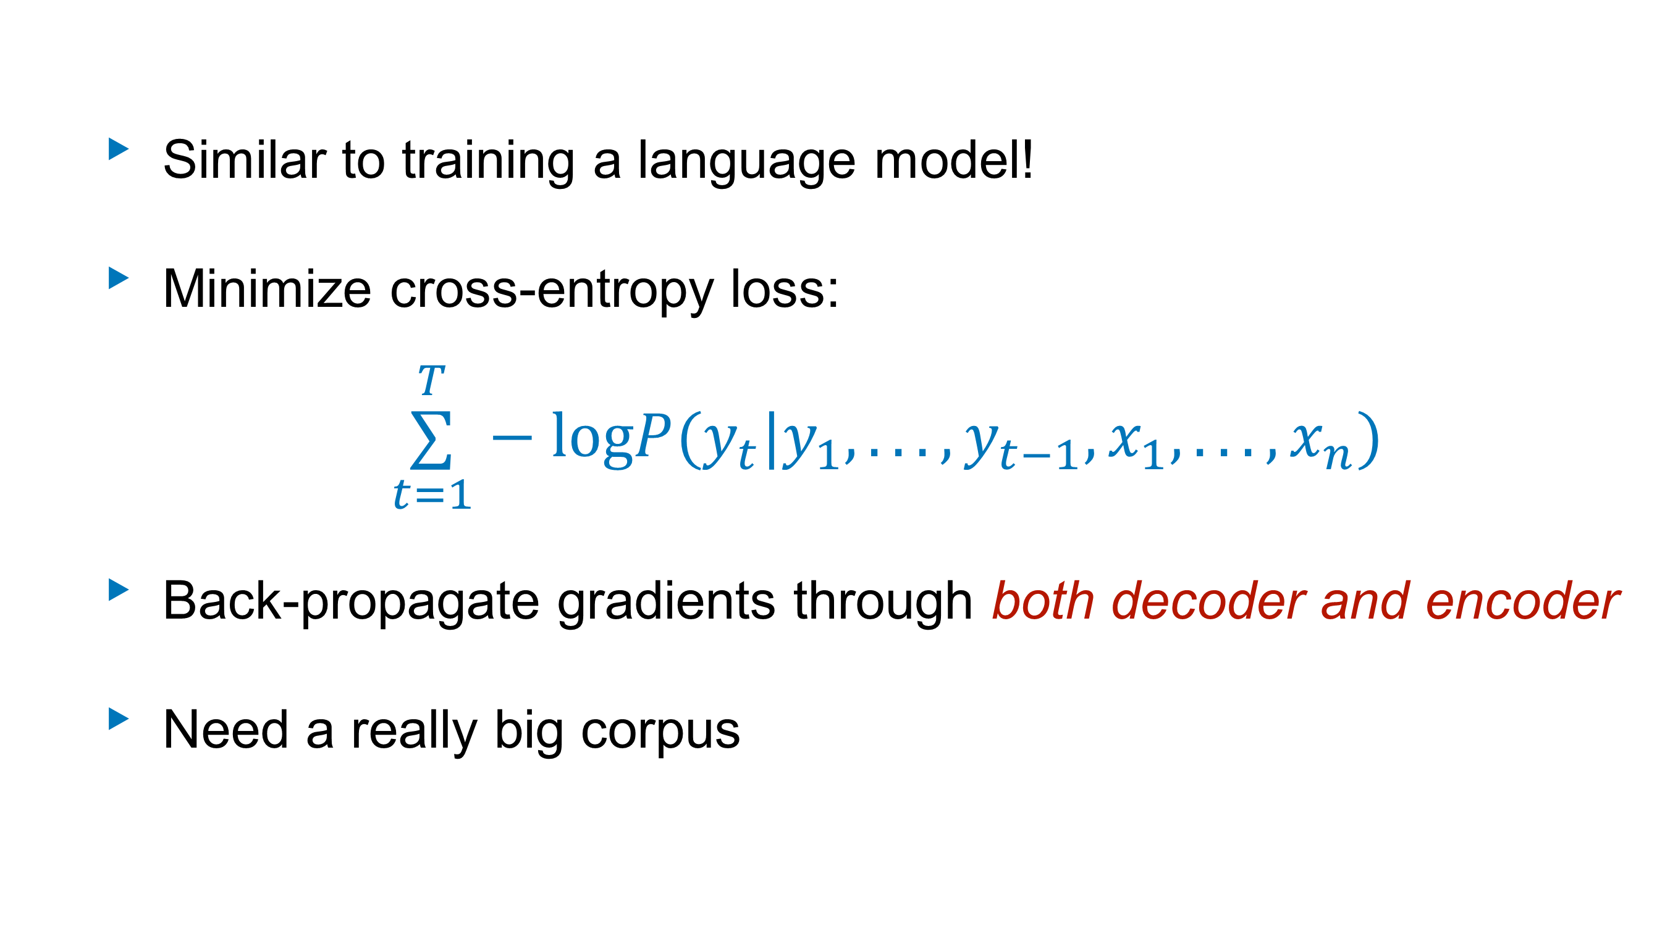
Seq2seq training
Similar to training a language model!
Minimize cross-entropy loss:
  $$\overset{T}{\underset{t=1}{∑}}−logP(y_{t}|y_{1},...,y_{t−1},x_{1},...,x_{n})$$
Back-propagate gradients through both decoder and encoder
Need a really big corpus
36M sentence pairs
Russian: Машинный перевод - это крутo!
English: Machine translation is cool!

Slide 20
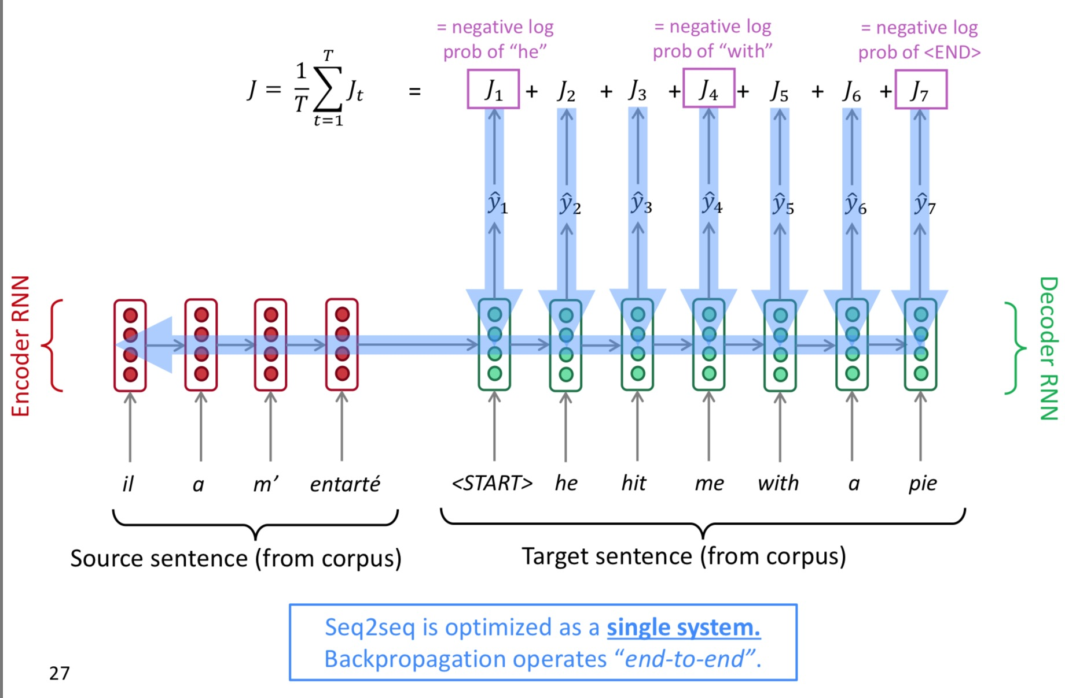
Seq2seq training
(slide credit: Abigail See)

Slide 21
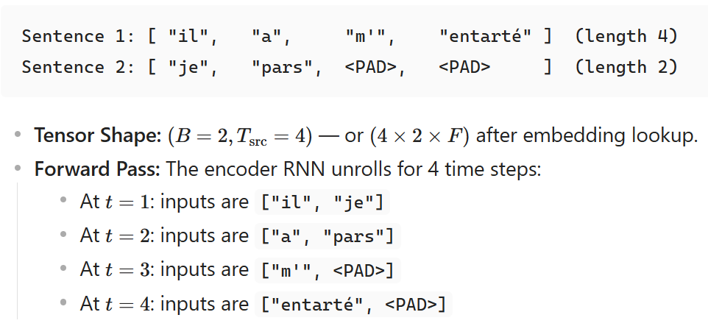
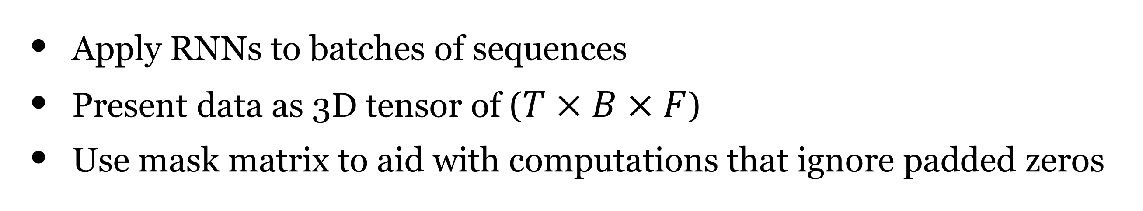




Efficient Training: Batching
Apply RNNs to batches of sequences
Present data as 3D tensor of ($T×B×F$)
Use mask matrix to aid with computations that ignore padded zeros
feature, or Embedding dimension
Padded sequences
Lengths
1 | 1 | 1 | 1 | 0 | 0
1 | 0 | 0 | 0 | 0 | 0
1 | 1 | 1 | 1 | 1 | 1
1 | 1 | 1 | 0 | 0 | 0
4
1
6
3

Slide 22
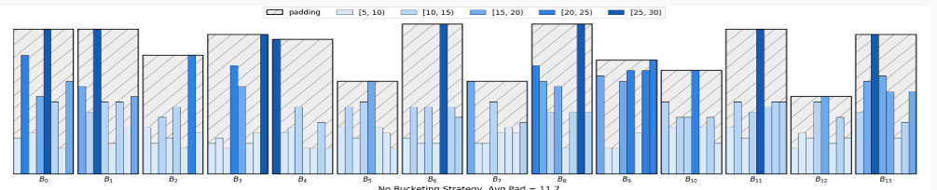
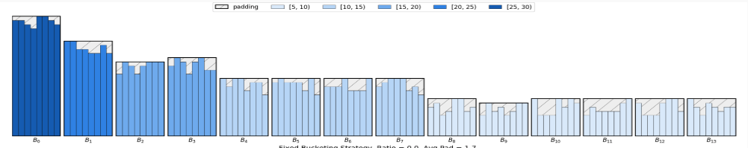
Batching
Sorting (partially) can help to create more efficient mini-batches
However, the input is less randomized
Unsorted
Sorted

Slide 23
Decoding strategies

Slide 24
Generation
How can we use our model (decoder) to generate sentences?
Sampling: Try to generate a random sentence according the the probability distribution
Argmax: Try to generate the best sentence, the sentence with the highest probability

Slide 25
Decoding Strategies
Pure (ancestral) sampling
Greedy decoding
Exhaustive search
Beam search
More on sampling

Slide 26
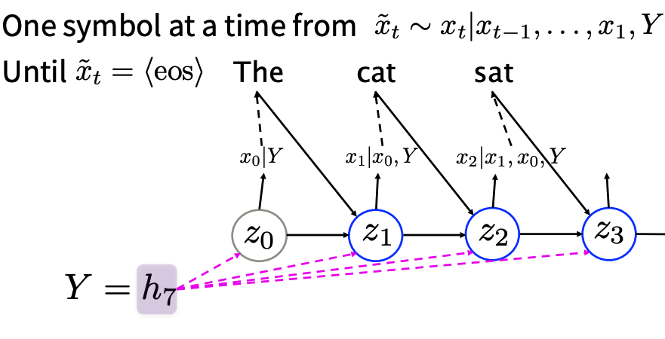
Pure (ancestral) Sampling
Randomly sample words one by one
Provides diverse output (high variance)
(figure credit: Luong, Cho, and Manning)

Slide 27
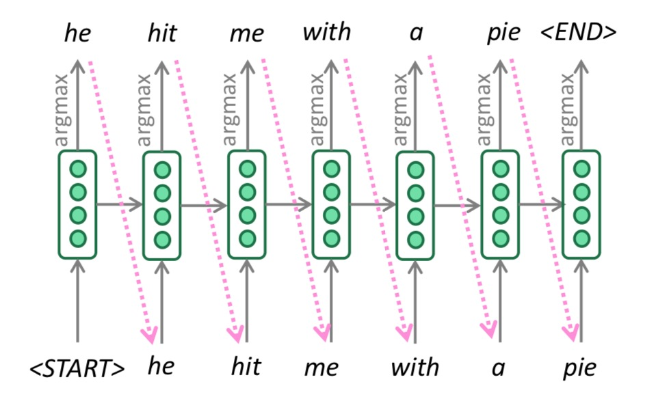
Greedy decoding
Compute argmax at every step of decoder to generate word
What’s wrong?

Slide 28
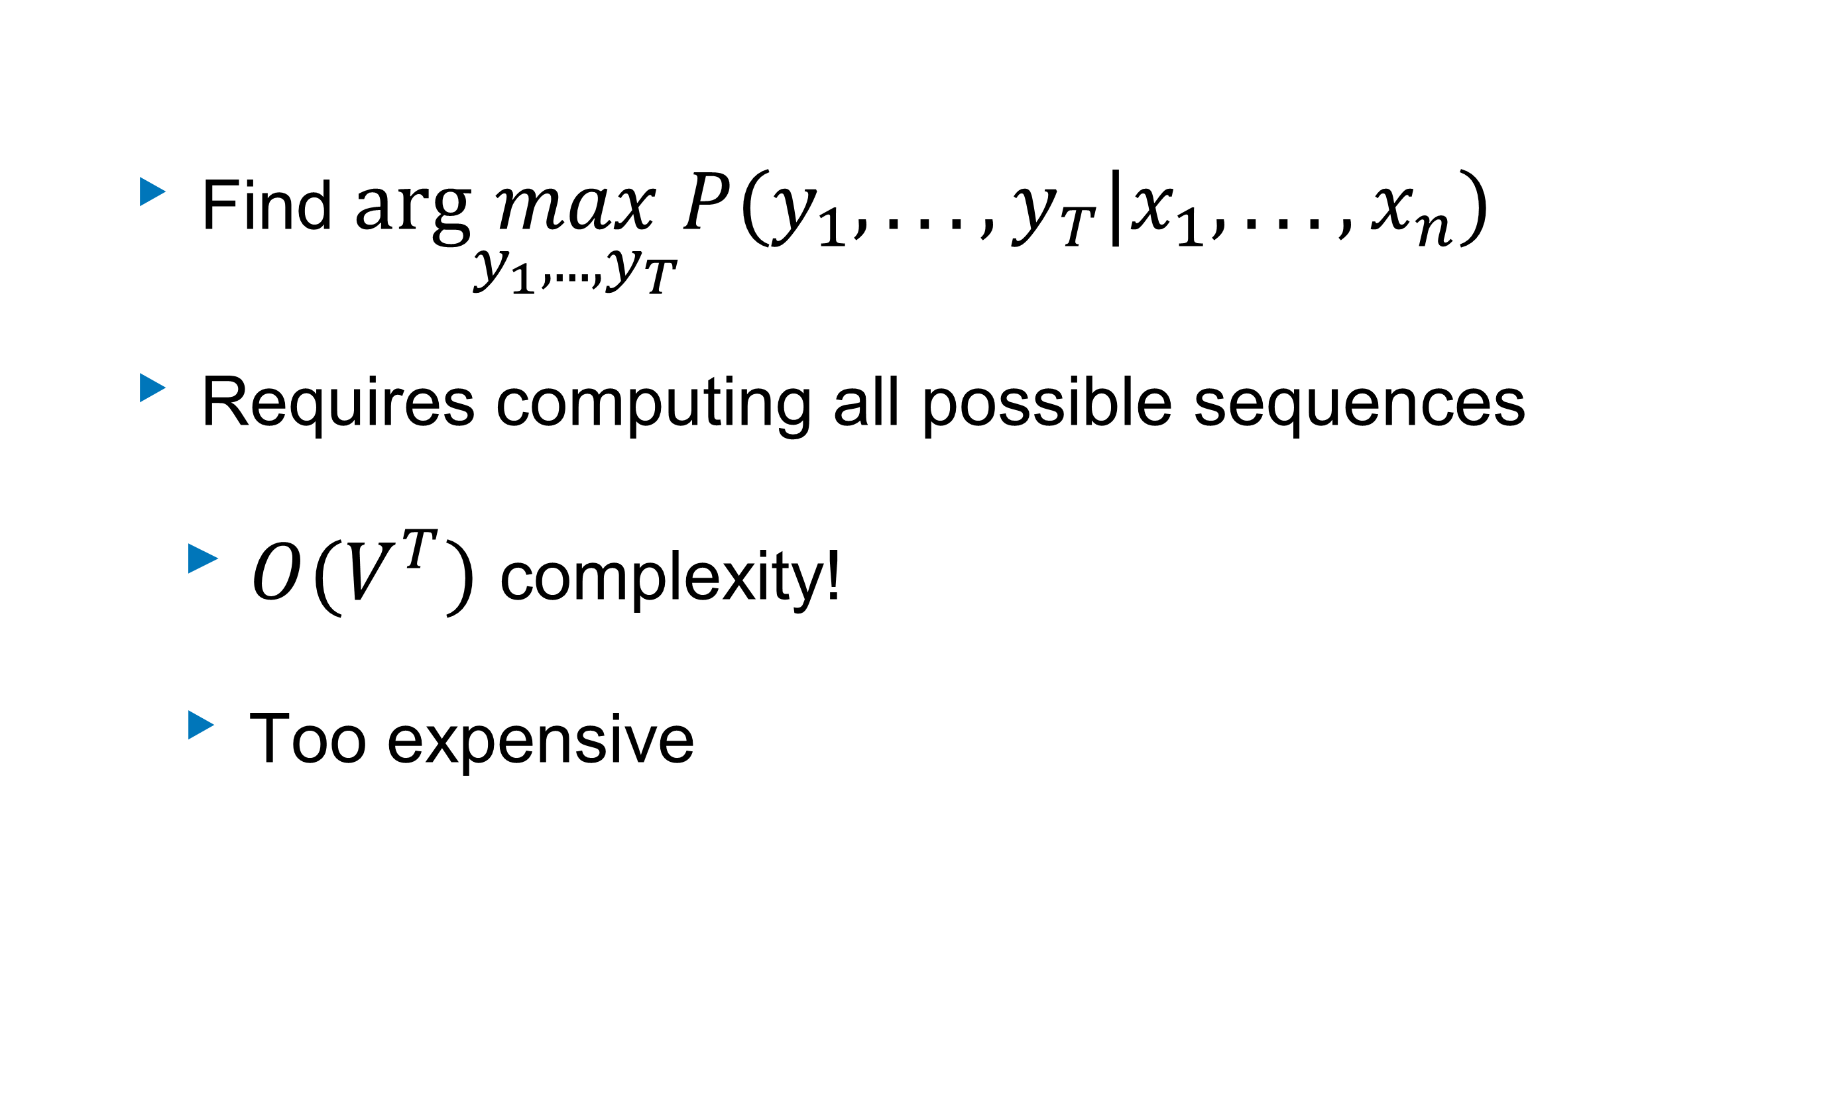
Exhaustive search?
Find $arg\max_{y_{1},...,y_{T}}P(y_{1},...,y_{T}|x_{1},...,x_{n})$
Requires computing all possible sequences
  $O(V^{T})$ complexity!
  Too expensive

Slide 29
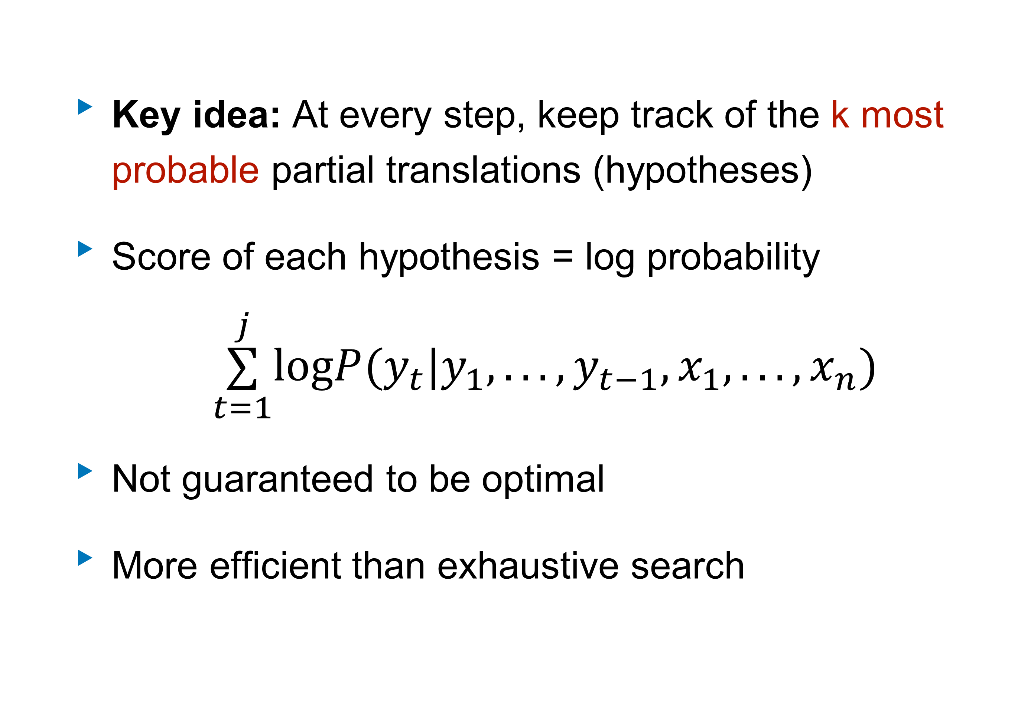
Recall: Beam search (a middle ground)
Key idea: At every step, keep track of the k most probable partial translations (hypotheses)
Score of each hypothesis = log probability
  $$\overset{j}{\underset{t=1}{∑}}logP(y_{t}|y_{1},...,y_{t−1},x_{1},...,x_{n})$$
Not guaranteed to be optimal
More efficient than exhaustive search

Slide 30
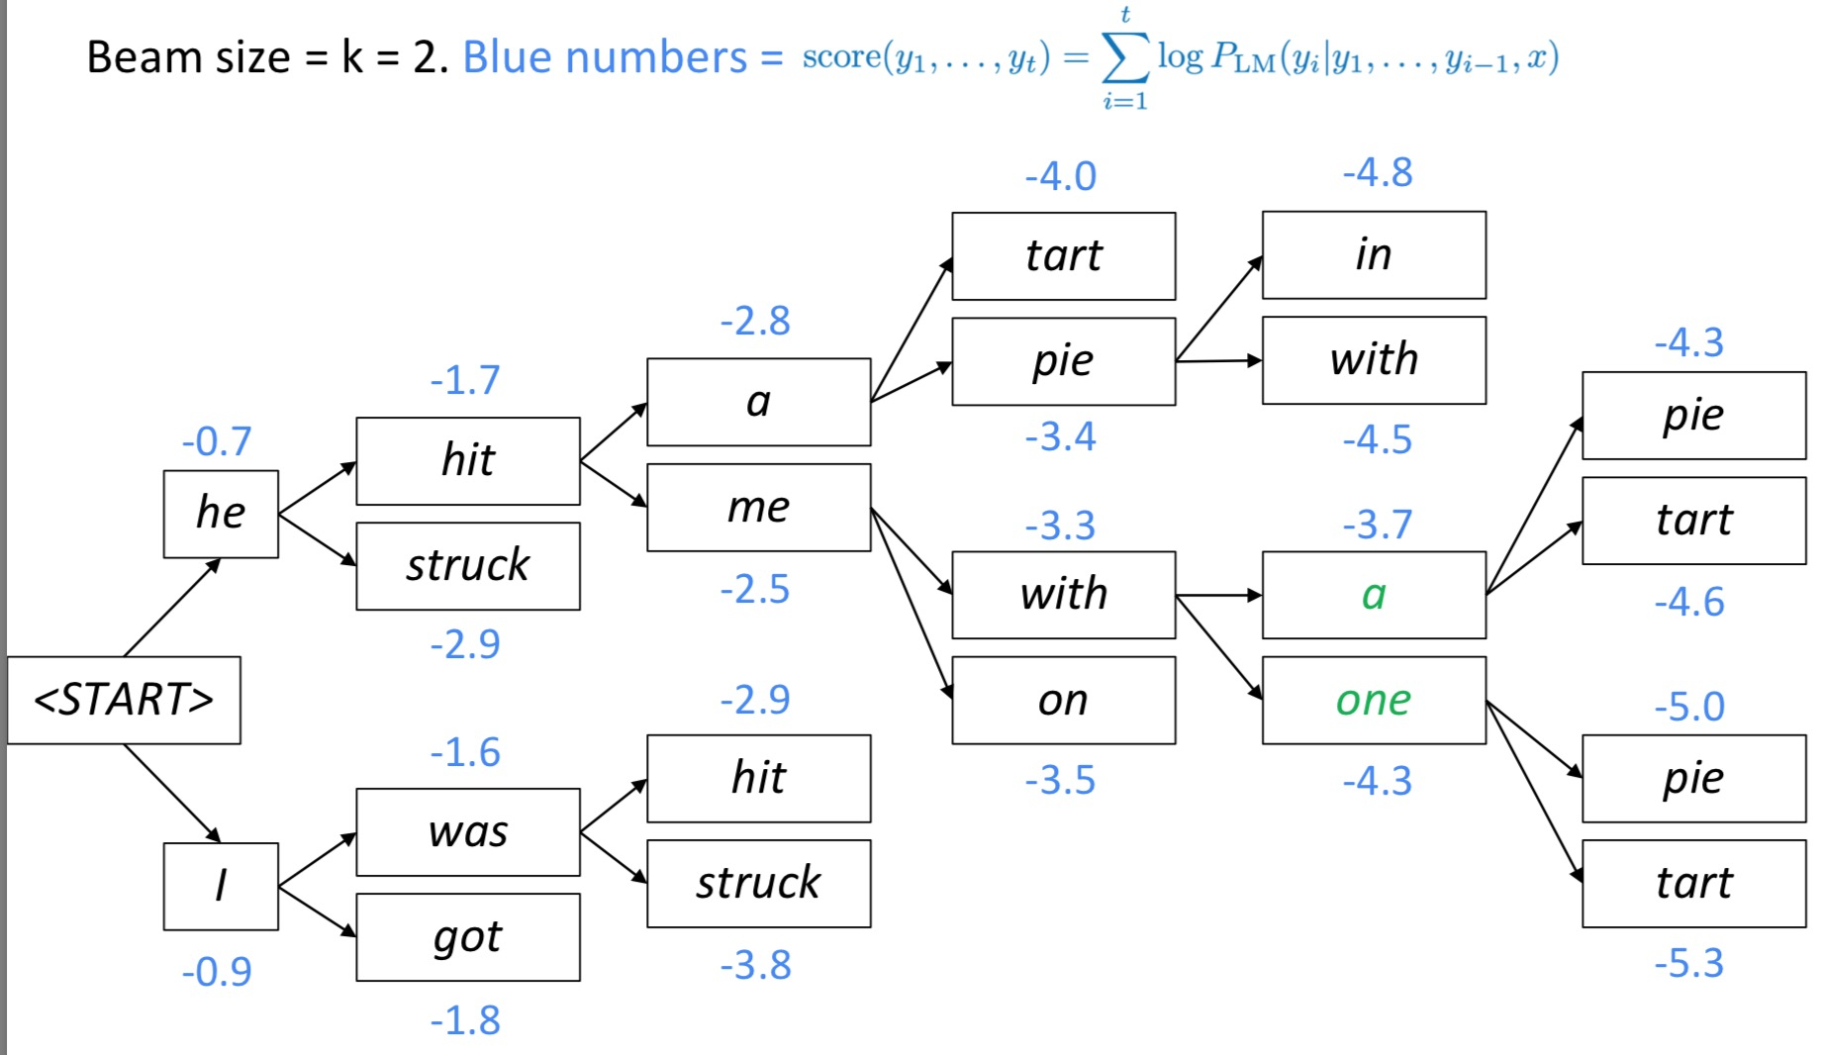
Beam decoding
(slide credit: Abigail See)

Slide 31
Beam decoding
(slide credit: Abigail See)

Slide 32
Beam decoding
(slide credit: Abigail See)

Slide 33
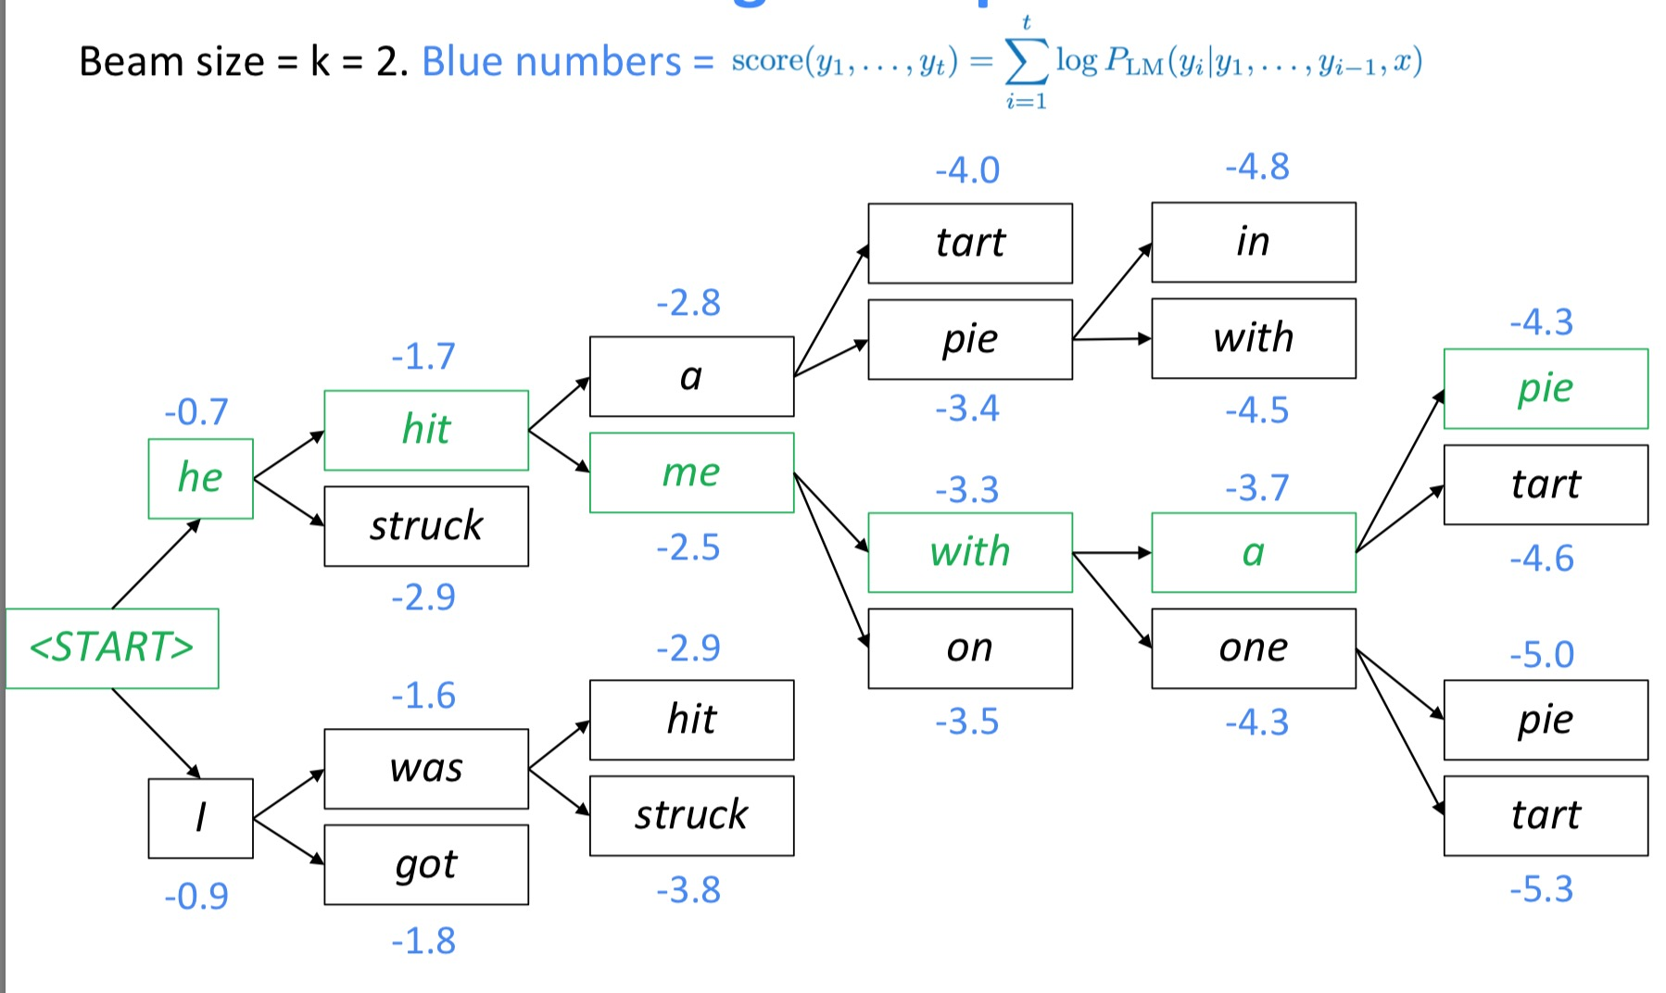
Backtrack
(slide credit: Abigail See)

Slide 34
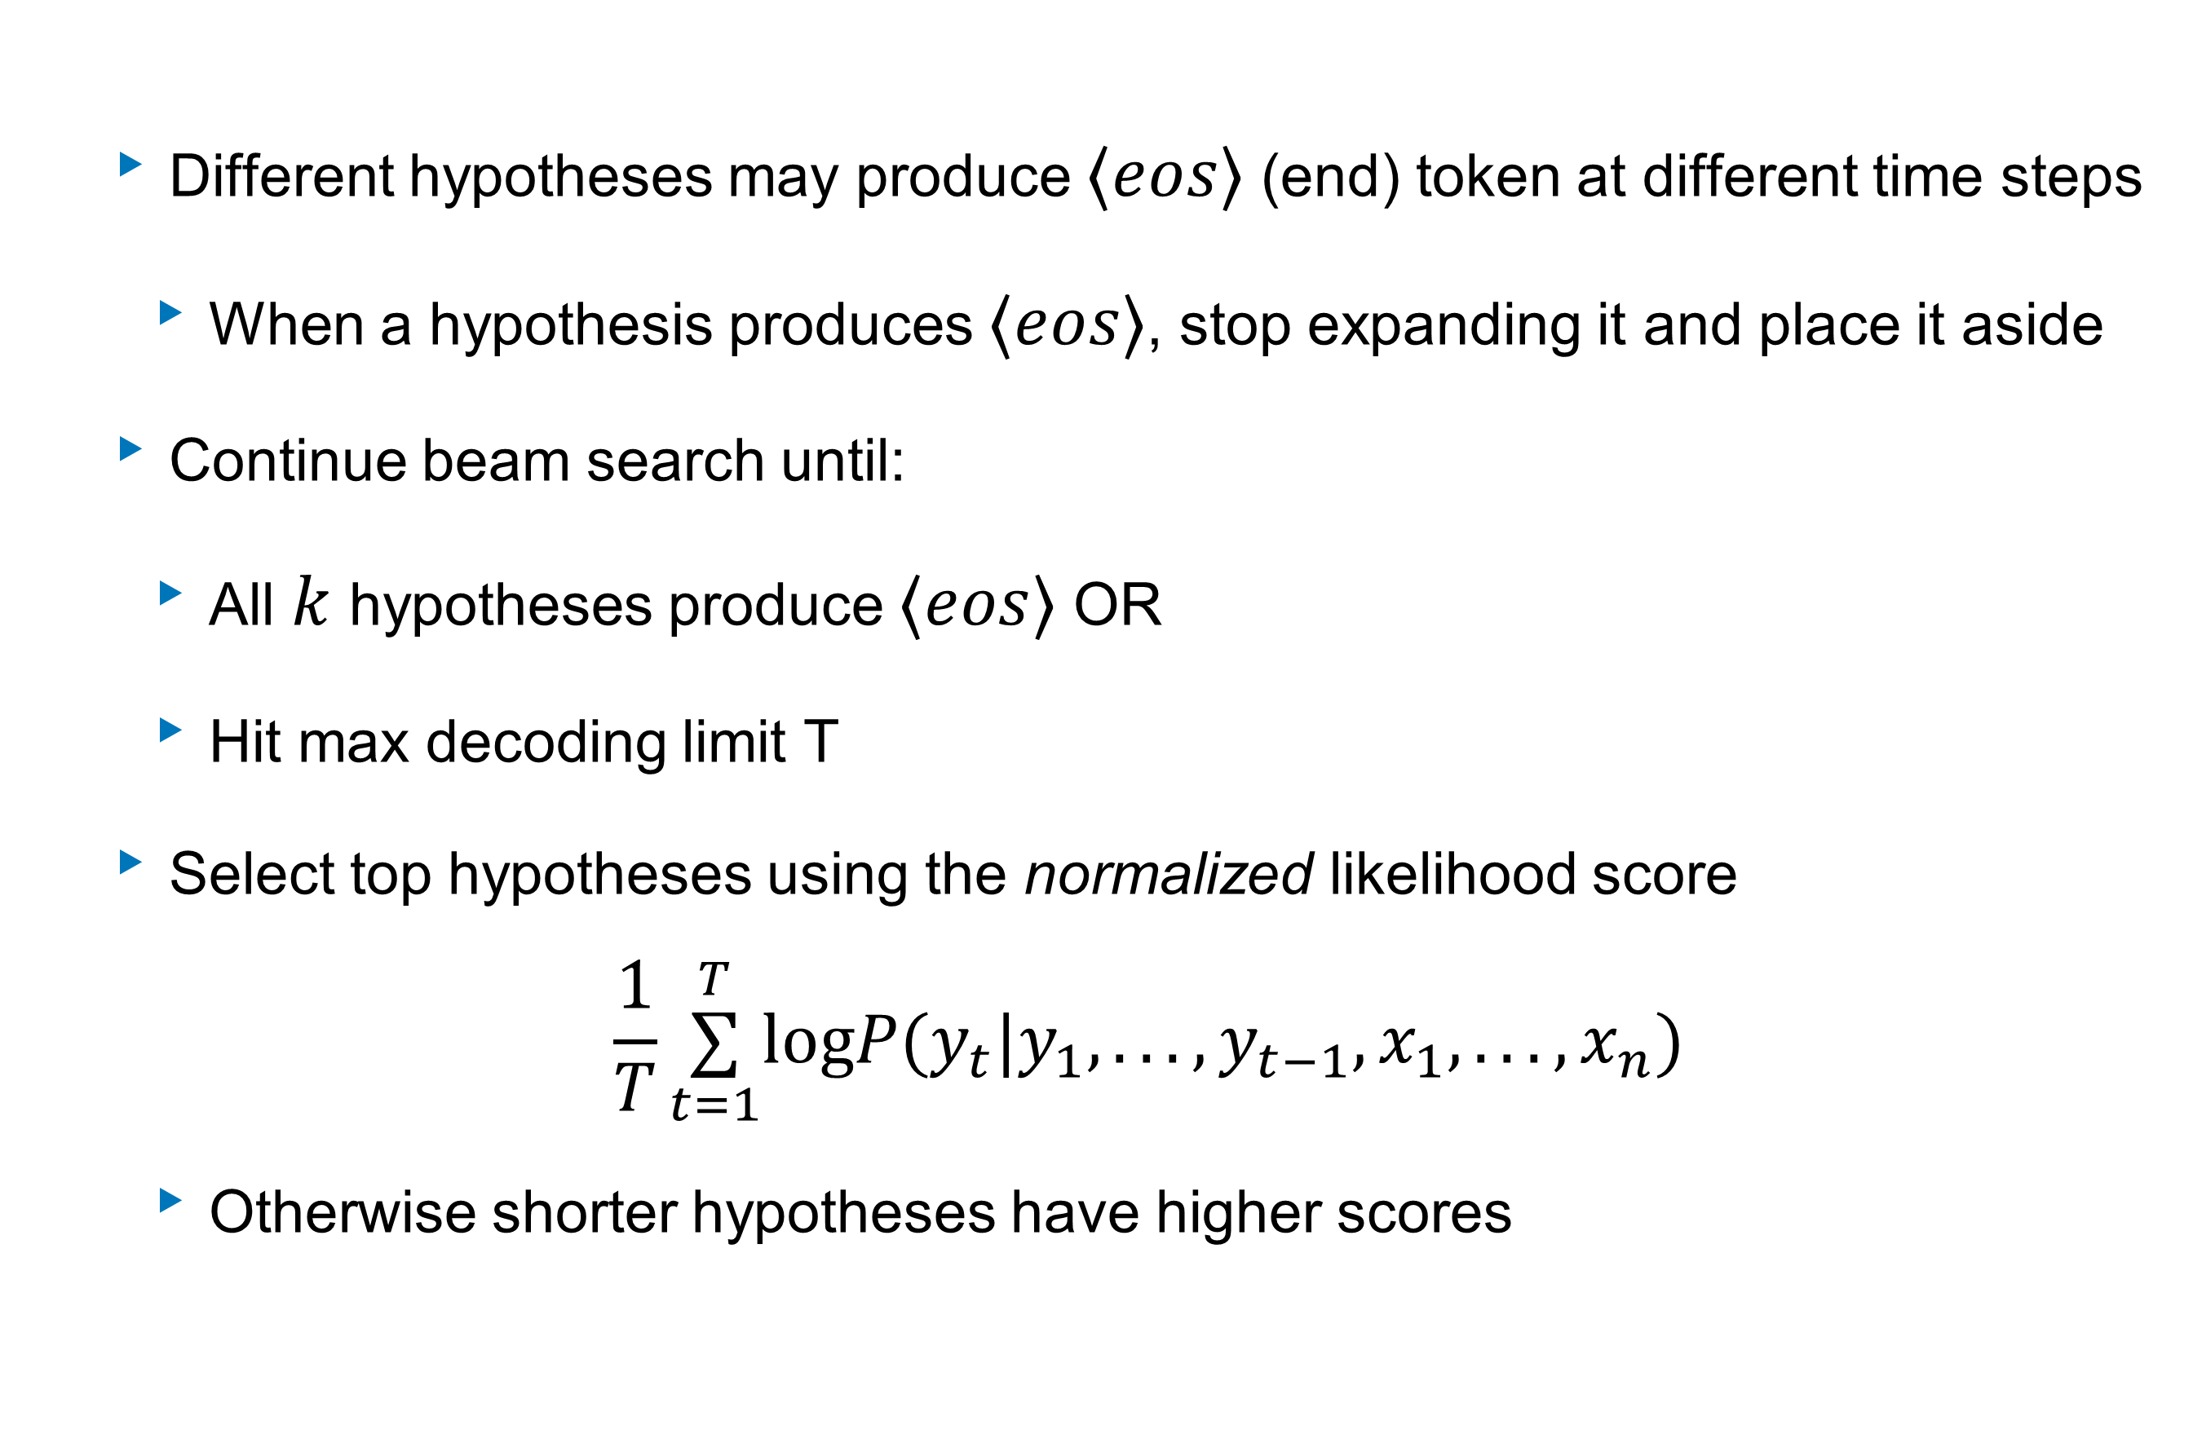
Beam decoding
Different hypotheses may produce $⟨eos⟩$ (end) token at different time steps
  When a hypothesis produces $⟨eos⟩$, stop expanding it and place it aside
Continue beam search until:
  All $k$ hypotheses produce $⟨eos⟩$ OR
  Hit max decoding limit T
Select top hypotheses using the normalized likelihood score
  $$\frac{1}{T}\overset{T}{\underset{t=1}{∑}}logP(y_{t}|y_{1},...,y_{t−1},x_{1},...,x_{n})$$
  Otherwise shorter hypotheses have higher scores

Slide 35
Beam Search Pitfalls
Beam search can still be very repetitive.
  Heuristic is to penalize repeated n-grams in the output.
  Manually set the probability of next words that could create an already seen n-gram to 0
  n should be greater than 2 or 3
The choices in beam search may not be very diverse.
  Similar continuations can happen due to common sub-trees in different branches
These issues are referred to as model degeneration

Slide 36
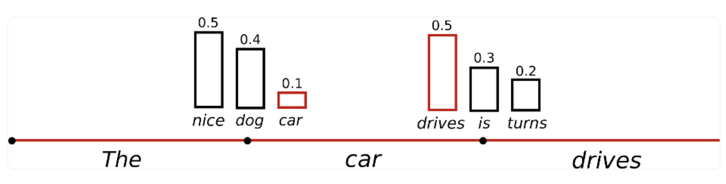
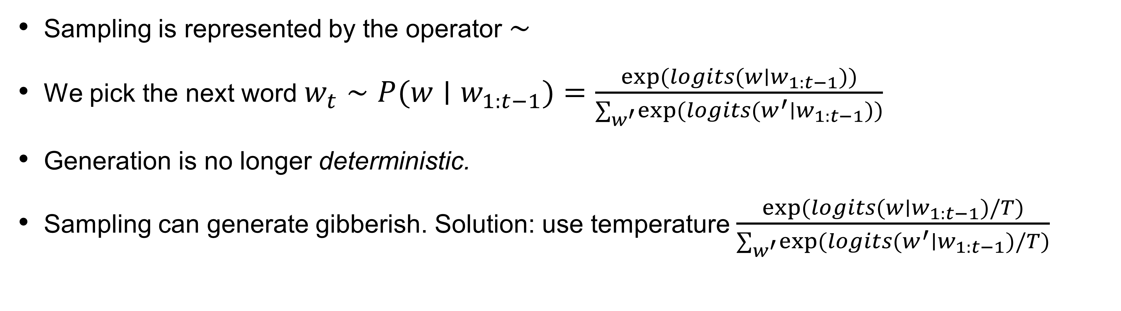
Sampling
Sampling is represented by the operator $∼$
We pick the next word $w_{t}∼P(w∣w_{1:t−1})=\frac{exp(logits(w∣w_{1:t−1}))}{∑_{w^{′}}exp(logits(w^{′}∣w_{1:t−1}))}$
Generation is no longer deterministic.
Sampling can generate gibberish. Solution: use temperature $\frac{exp(logits(w∣w_{1:t−1})/T)}{∑_{w^{′}}exp(logits(w^{′}∣w_{1:t−1})/T)}$

Slide 37
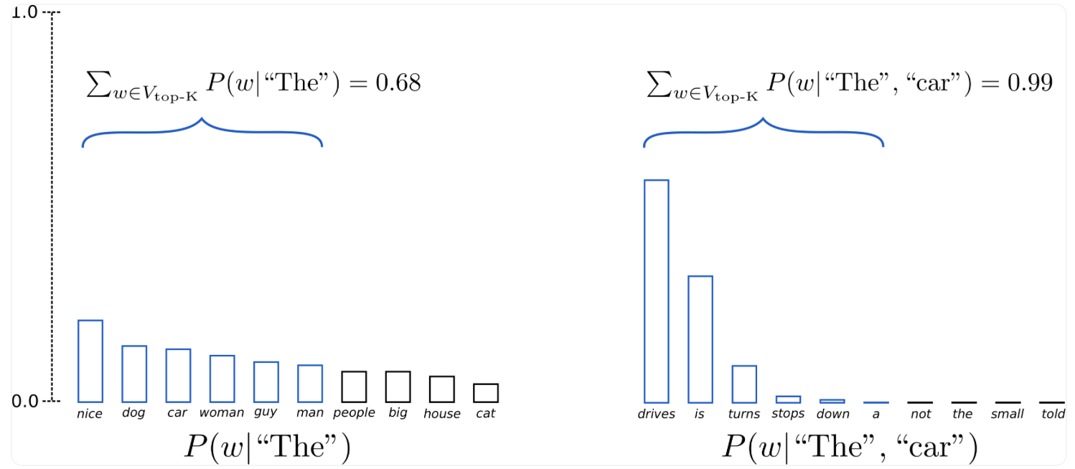
Top-k Sampling
K most likely next words are filtered and we re-normalize over the K words
GPT2 showed that this worked better than beam search
K=6

Slide 38
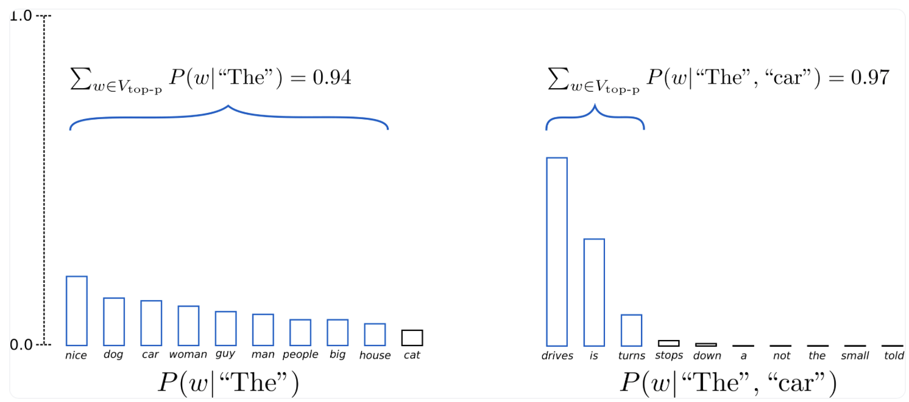
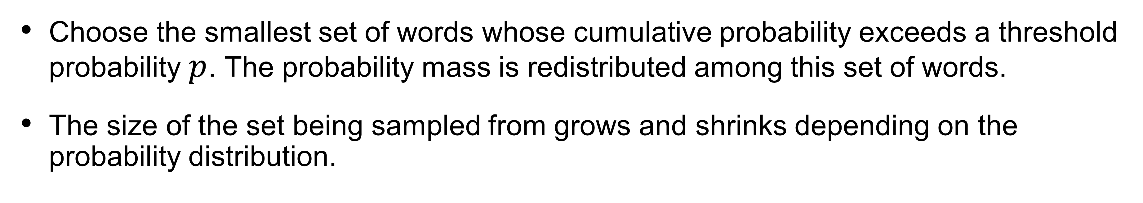
Top-p Nucleus Sampling
Choose the smallest set of words whose cumulative probability exceeds a threshold probability $p$. The probability mass is redistributed among this set of words.
The size of the set being sampled from grows and shrinks depending on the probability distribution.

Slide 39
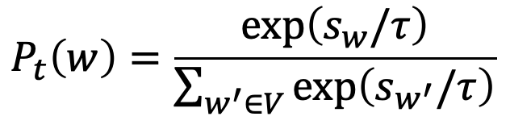
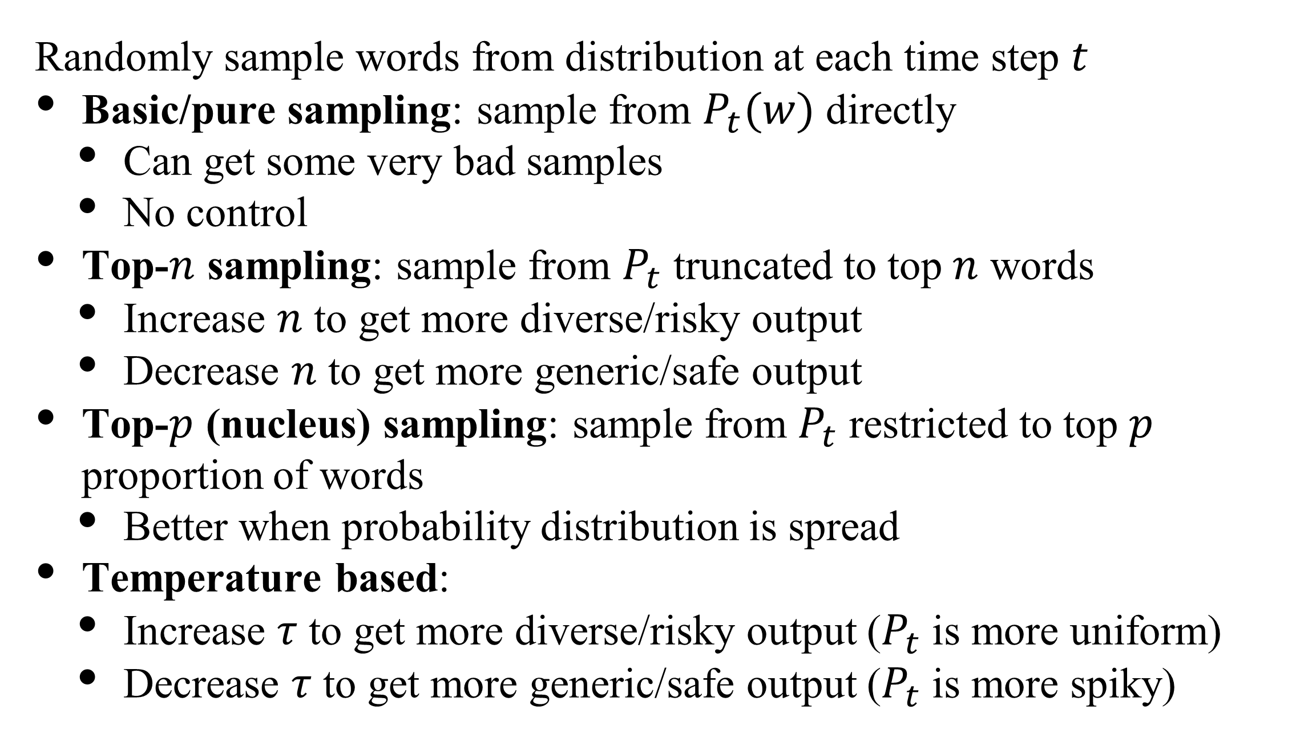
Summary of sampling for text generation
Sampling
Randomly sample words from distribution at each time step $t$
Basic/pure sampling: sample from $P_{t}(w)$ directly
  Can get some very bad samples
  No control
Top-$n$ sampling: sample from $P_{t}$ truncated to top $n$ words
  Increase $n$ to get more diverse/risky output
  Decrease $n$ to get more generic/safe output
Top-$p$ (nucleus) sampling: sample from $P_{t}$ restricted to top $p$ proportion of words
  Better when probability distribution is spread
Temperature based:
  Increase $τ$ to get more diverse/risky output ($P_{t}$ is more uniform)
  Decrease $τ$ to get more generic/safe output ($P_{t}$ is more spiky)
Repetitive
A: Where are you going?
B: I’m going to the restroom.
A: See you later.
B: See you later.
A: See you later.
B: See you later.
Sample and Rank
Sample N candidate
Rank candidate and select best one
(adapted from slides: Stanford CS224N, Chris Manning)

Slide 40
Evaluating text generation

Slide 41
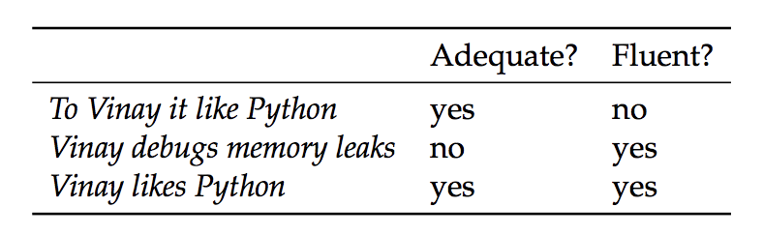
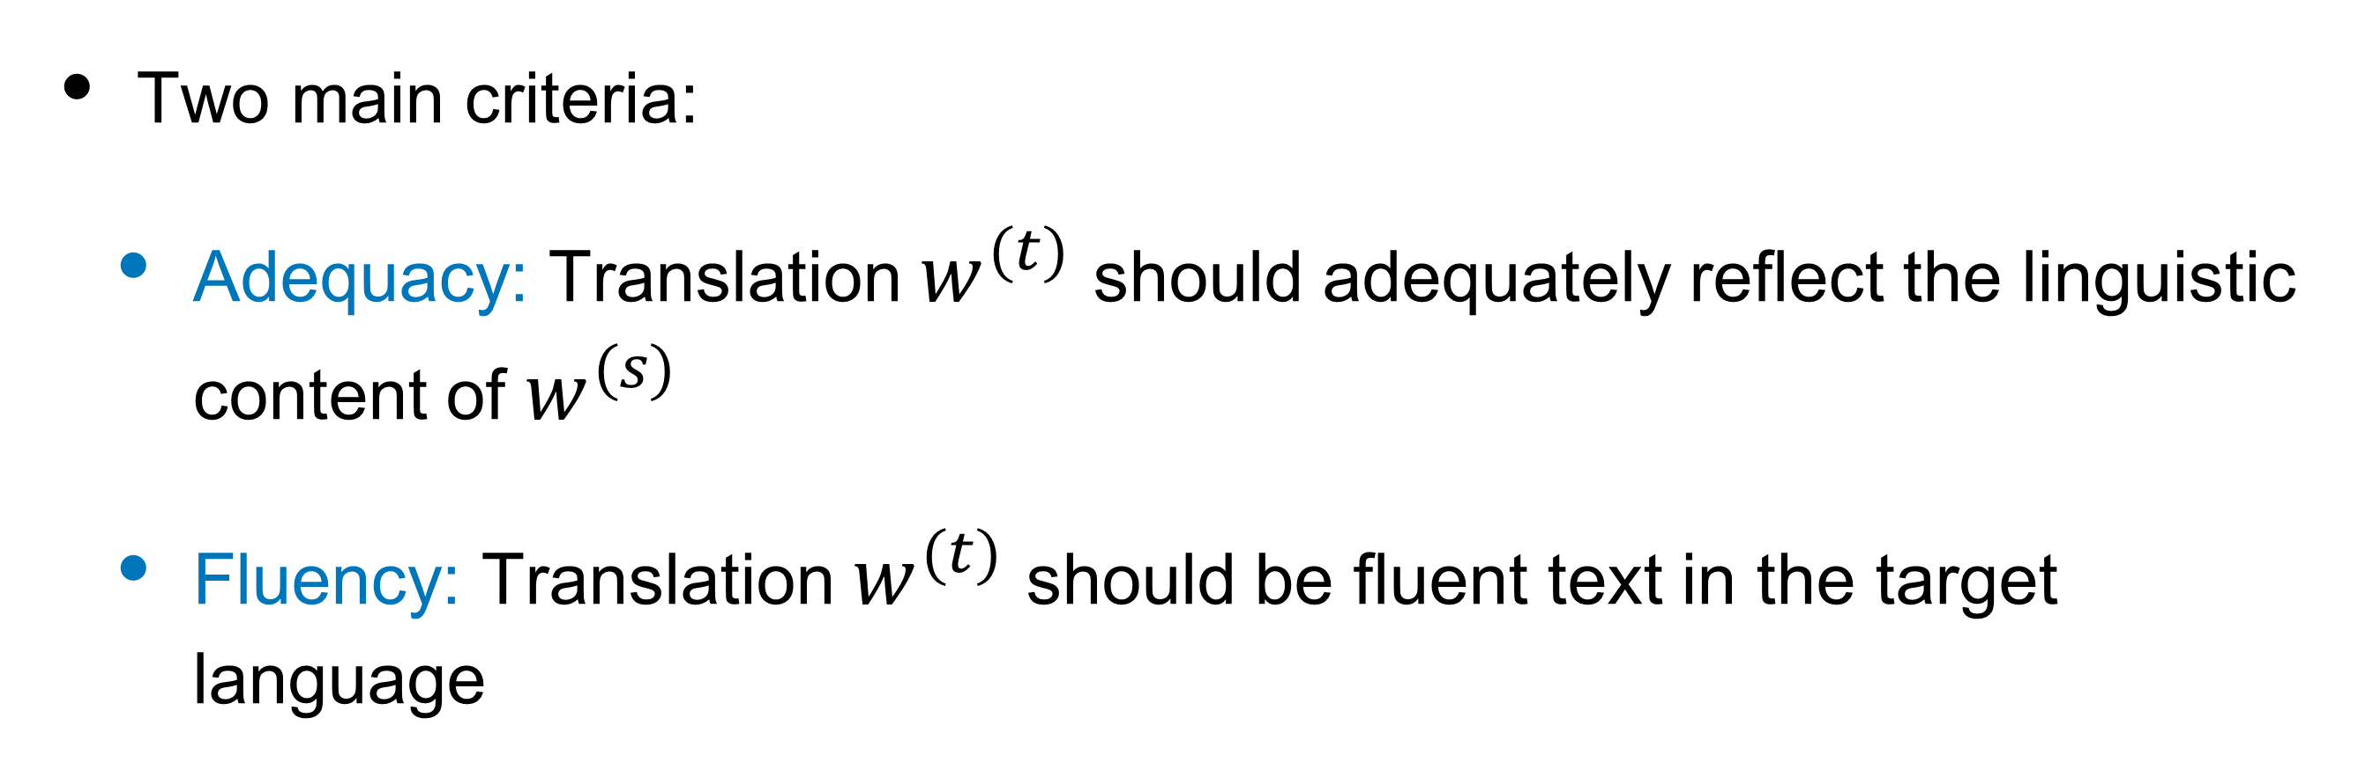
Evaluating translation quality
Two main criteria:
  Adequacy: Translation $w^{(t)}$ should adequately reflect the linguistic content of $w^{(s)}$
  Fluency: Translation $w^{(t)}$ should be fluent text in the target language
Different translations of A Vinay le gusta Python

Slide 42
Evaluation metrics
Manual evaluation is most accurate, but expensive
Automated evaluation metrics:
  Compare system hypothesis with reference translations
  BiLingual Evaluation Understudy (BLEU) (Papineni et al., 2002)
    Modified n-gram precision
reference
hypothesis
hypothesis

Slide 43
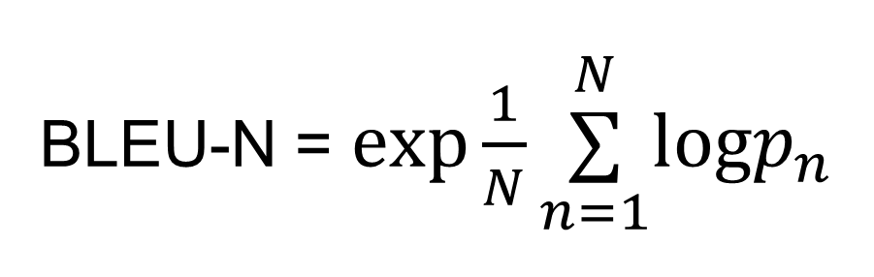
BLEU
BLEU-N = $exp\frac{1}{N}\overset{N}{\underset{n=1}{∑}}logp_{n}$
n-gram precision
geometric mean over several values of n (up to N=4)
Example
  Reference: Vinay likes programming in Python
Hypothesis/Candidate | p1 | p2 | BLEU-2
Vinay likes Python | 3/3 | 1/2 | 0.7071
To Vinay it like Python | 2/5 | 0 | ???
https://www.aclweb.org/anthology/P02-1040.pdf
Notes:
Why repeating words not so good?
Why precision based metrics favor short translations?

Slide 44
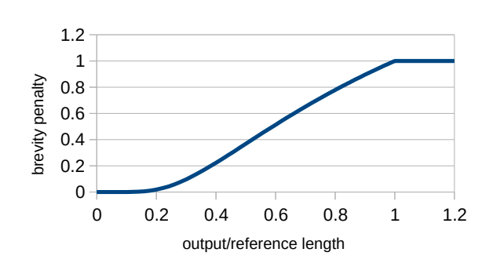

BLEU
n-gram precision
Two modifications:
  To avoid $log0$, all precisions are smoothed
  Each n-gram in reference can be used at most once
    Ex. Hypothesis: to to to to to vs Reference: to be or not to be should not get a unigram precision of 1 ($p_{1}=2/5$)
Precision-based metrics favor short translations
  Solution: Multiply score with a brevity penalty for translations shorter than reference, $BP=e^{1−r/h}$
BLEU-N = $exp\frac{1}{N}\overset{N}{\underset{n=1}{∑}}logp_{n}$
geometric mean over several values of n (up to N=4)
Various smoothing techniques
add 1 to numerator/denominator
clipped count
r = reference length, h = hypothesis length
Notes:
Why repeating words not so good?
Why precision based metrics favor short translations?
http://www.phontron.com/class/mtandseq2seq2018/assets/slides/mt-fall2018.chapter11.pdf

Slide 45
BLEU
Correlates somewhat well with human judgements
(G. Doddington, NIST)

Slide 46


BLEU scores
https://www.nltk.org/_modules/nltk/translate/bleu_score.html
Sample BLEU scores for various system outputs
$$BP=e^{1−r/h}$$
Length
5
7
3
6
Example from: https://github.com/jacobeisenstein/gt-nlp-class/tree/master/notes
Issues?
Alternatives have been proposed:
  METEOR: weighted F-measure
  Translation Error Rate (TER): Edit distance between hypothesis and reference
Number is not that meaningful (BLEU will be higher for some language than others)
Does not account for different word choices (synonyms)
Does not account for morphology
Does not penalize omitting important words
Notes:
Make sure tokenization + normalization the same across systems
http://www.cs.cmu.edu/~alavie/papers/ACL-08-WMT-METEOR.pdf
https://medium.com/explorations-in-language-and-learning/metrics-for-nlg-evaluation-c89b6a781054

Slide 47

BLEU useful despite issues
easy to compute
automated
consistent
Minor note about <UNK>
Make sure you compare against the original reference
(Don’t have <UNK>s in your reference)
Re-evaluating Automatic Metrics for Image Captioning
[Kilickaya et al, EACL 2017]

Slide 48
Sequence to sequence models with attention

Slide 49

Issues with vanilla seq2seq
Bottleneck
A single encoding vector, $h^{enc}$, needs to capture all the information about source sentence
Longer sequences can lead to vanishing gradients
Overfitting

Slide 50

Issues with vanilla seq2seq
Bottleneck
A single encoding vector, $h^{enc}$, needs to capture all the information about source sentence
Longer sequences can lead to vanishing gradients
Overfitting

Slide 51

Attention
The neural MT equivalent of alignment models
Key idea: At each time step during decoding, focus on a particular part of source sentence
  This depends on the decoder’s current hidden state (i.e. notion of what you are trying to decode)
  Usually implemented as a probability distribution over the hidden states of the encoder ( $h_{i}^{enc}$ )

Slide 52

Seq2seq with attention
(slide credit: Abigail See)

Slide 53

Seq2seq with attention
(slide credit: Abigail See)

Slide 54

Seq2seq with attention
(slide credit: Abigail See)

Slide 55


Seq2seq with attention
Can also use ${\overset{̂}{y}}_{1}$ as input for next time step
(slide credit: Abigail See)

Slide 56

Seq2seq with attention
(slide credit: Abigail See)

Slide 57


Computing attention
Encoder hidden states: $h_{1}^{enc},...,h_{n}^{enc}$
Decoder hidden state at time $t$: $h_{t}^{dec}$
First, get attention scores for this time step (we will see what $g$ is soon!):
$e^{t}=[g(h_{1}^{enc},h_{t}^{dec}),...,g(h_{n}^{enc},h_{t}^{dec})]$
Obtain the attention distribution using softmax:
$α^{t}=\text{softmax}(e^{t})∈ℝ^{n}$
Compute weighted sum of encoder hidden states:
$a_{t}=\overset{n}{\underset{i=1}{∑}}α_{i}^{t}h_{i}^{enc}∈ℝ^{h}$
Finally, concatenate with decoder state and pass on to output layer: $[a_{t};h_{t}^{dec}]∈ℝ^{2h}$

Slide 58


Types of attention
Assume encoder hidden states $h_{1},h_{2},...,h_{n}$ and decoder hidden state $z$
Dot-product attention:
$g(h_{i},z)=z^{T}h_{i}∈ℝ$
Bilinear / multiplicative attention:
$g(h_{i},z)=z^{T}Wh_{i}∈ℝ$, where $W$ is a weight matrix
Additive attention (essentially MLP):
$g(h_{i},z)=v^{T}\text{tanh}(W_{1}h_{i}+W_{2}z)∈ℝ$
where $W_{1},W_{2}$ are weight matrices and $v$ is a weight vector
Simplest (no extra parameters)
requires $z$ and $h_{i}$ to be same size
more efficient
(matrix multiplication)
More flexible
than dot-product
(W is trainable)
Perform better for
larger dimensions
Notes:
https://lilianweng.github.io/lil-log/2018/06/24/attention-attention.html

Slide 59
Attention can be applied to other modalities

Slide 60


Attention on other modalities
Images
Image Credit: Peter Anderson
Agent experience

Slide 61
Image captioning example
Xu et al. ICML 2015

Slide 62


Soft vs Hard Attention
Xu et al. ICML 2015

Slide 63


Global vs Local Attention
• Global: attention over the entire input
• Local: attention over a window (or subset) of the input

Slide 64

Self-Attention
Attention (correlation) with different parts of itself
Transformers: modules with scaled dot-product self-attention
https://ai.googleblog.com/2017/08/transformer-novel-neural-network.html

Slide 65
Transformers: self-attention
More recent models (e.g. Transformer, Vaswani et al., 2017) have replaced RNNs entirely with attention mechanisms
Theoretically limiting (since recurrence can help handle arbitrarily long sequences)
Huge gains in practical performance

Slide 66

Issues with vanilla seq2seq
Bottleneck
A single encoding vector, $h^{enc}$, needs to capture all the information about source sentence
Longer sequences can lead to vanishing gradients
Overfitting

Slide 67



Exposure bias
Discrepancy in model input between training and generation time
During training, model inputs are gold context tokens
At generation time, inputs are previously-decoded tokens
Student forcing: use predicted tokens during training
Scheduled sampling: use decoded token with some probability p, increase p over time

Slide 68

Scheduled Sampling
Possible decay schedules
(probability using true y decays over time)
(figure credit: Bengio et al, 2015)
Notes:
https://arxiv.org/pdf/1506.03099.pdf
Faster, more efficient training

Slide 69
Regularization
Weight decay
Label smoothing
Dropout
Ensembling

Slide 70

Weight decay
Weight decay
  Decays weights $θ$ exponentially
  $θ^{t+1}=(1−λ)θ^{t}−η\frac{d}{dθ}L(θ)$
For SGD, weight decay and L2 regularization are equivalent

Slide 71



Weight decay and SGD
SGD
  $θ_{t+1}=θ_{t}−η\frac{d}{dθ}L(θ)$
L2 regularization
  $L_{\text{L}\text{2}}=L(θ)+α∥θ∥_{2}^{2}$
  $\frac{dL_{\text{L}\text{2}}}{d}=\frac{dL(θ)}{dθ}+2αθ$
SGD with L2 regularization
  $θ_{t+1}=θ_{t}−η\frac{d}{dθ}L_{\text{L}\text{2}}(θ)$
  $θ_{t+1}=(1−2ηα)θ_{t}−η\frac{d}{dθ}L(θ)$
L2 regularization with $α=\frac{λ}{2η}$ gives
  $θ_{t+1}=(1−λ)θ_{t}−η\frac{d}{dθ}L(θ)$
Notes:
Inverted dropout

Slide 72
Weight decay
Weight decay
  Decays weights $θ$ exponentially
  $θ^{t+1}=(1−λ)θ^{t}−η\frac{d}{dθ}L(θ)$
For SGD, weight decay and L2 regularization are equivalent
Weight decay and L2 regularization are not necessarily equivalent for adaptive optimizers
Can decouple weight decay and learning rate parameters
  AdamW
But for this to hold, the weight decay and learning rate are coupled for a desired L2 regularization
Notes:
With L2 regularization both types of gradients are normalized by their typical (summed) magnitudes, and
therefore weights x with large typical gradient magnitude s are regularized by a smaller relative
amount than other weights
Decoupled weight decay regularizes all weights with the
same rate λ, effectively regularizing weights x with large s more than standard L2 regularization

Slide 73


Label smoothing
Cross entropy loss
  $L=−\overset{K}{\underset{k=1}{∑}}q(k)logp(k)$
  Ground-truth $q(k)=δ(y)=1[y=k]$
Label smoothing
  Smoothed distribution for training
  $q(k)=εδ(y)+(1−ε)u(k)$
  $u(k)$ is prior - simplest prior is the uniform distribution: $u(k)=\frac{1}{K}$
Figure from https://blog.dailydoseofds.com/p/label-smoothing-the-overlooked-and

Slide 74

Regularization: Dropout
Form of regularization for RNNs (and any NN in general)
Idea: “Handicap” NN by removing hidden units stochastically
  set each hidden unit in a layer to 0 with probability $p$ during training ( $p=0.5$ usually works well)
  scale outputs by $1/(1−p)$
  hidden units forced to learn more general patterns
Test time: Use all activations (no need to rescale)
Notes:
At test time - each neuron is always present

Slide 75

Dropout and attention improves translation
WMT’14 English to German Results
(Luong et al, 2015)

Slide 76
Other challenges with NMT
Out of vocabulary (OOV)
Low-resource languages
Long-term context
Common sense knowledge (e.g. hot dog, paper jam)
Fairness and bias
Interpretability

Slide 77


Out of vocabulary (OOV)
Subword-modeling
Copy mechanism
Character level GRU
Byte-pair encoding
Probability of generating from vocabulary or copying from input
Probability of copying specific word (similar to attention)
(Lee et al, 2017)
(See et al, 2017)

Slide 78

(Araabi and Monz, 2020)

